Slide 1
Transaction

Slide 2
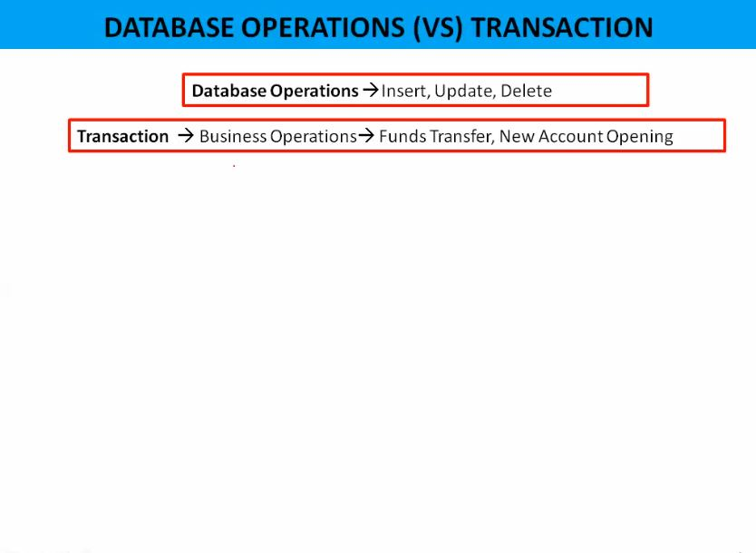
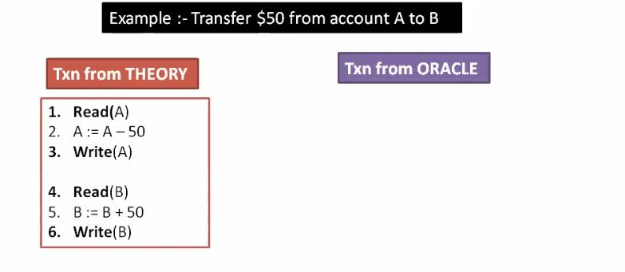
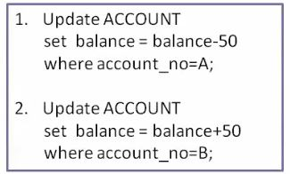

Slide 3
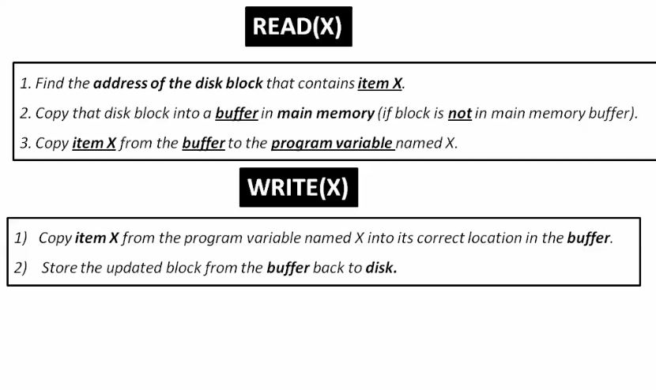

Slide 4
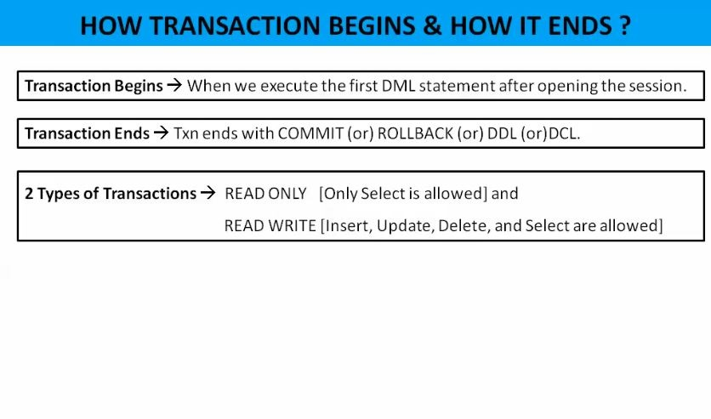
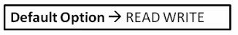

Slide 5
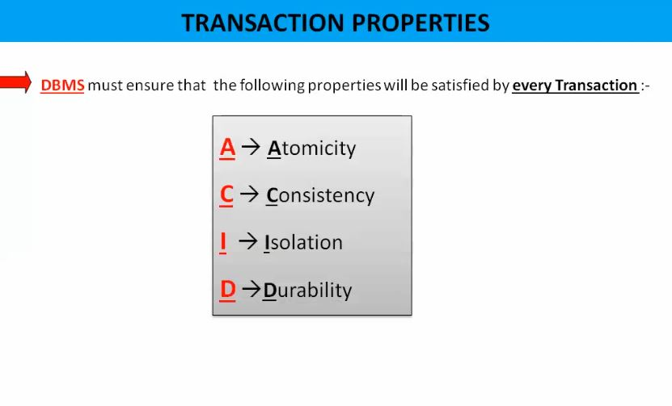

Slide 6
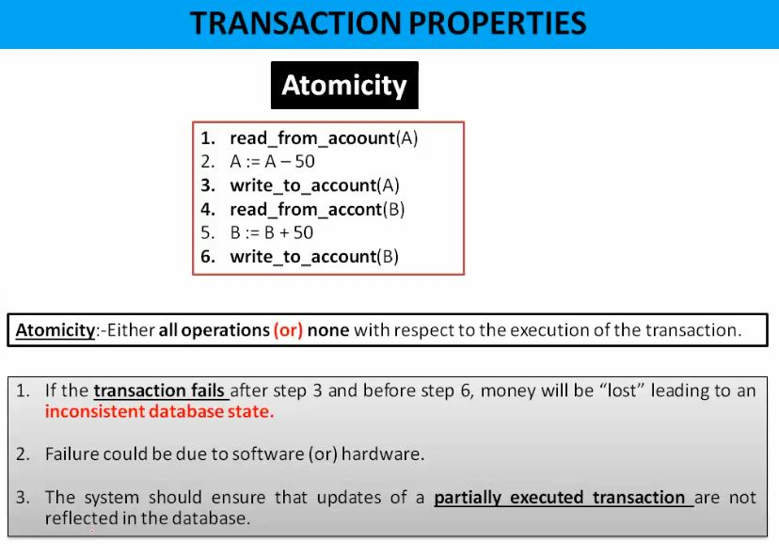

Slide 7
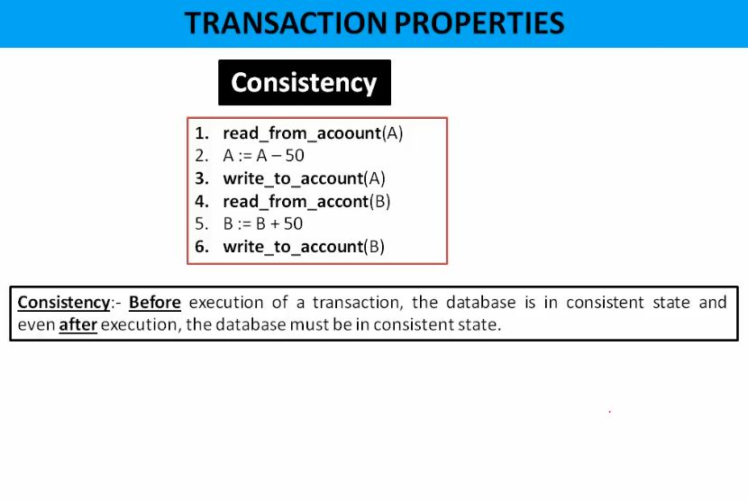
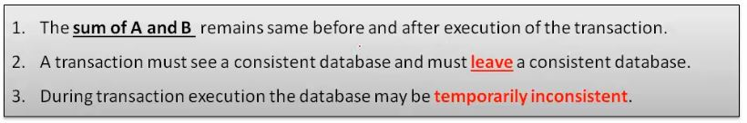

Slide 8
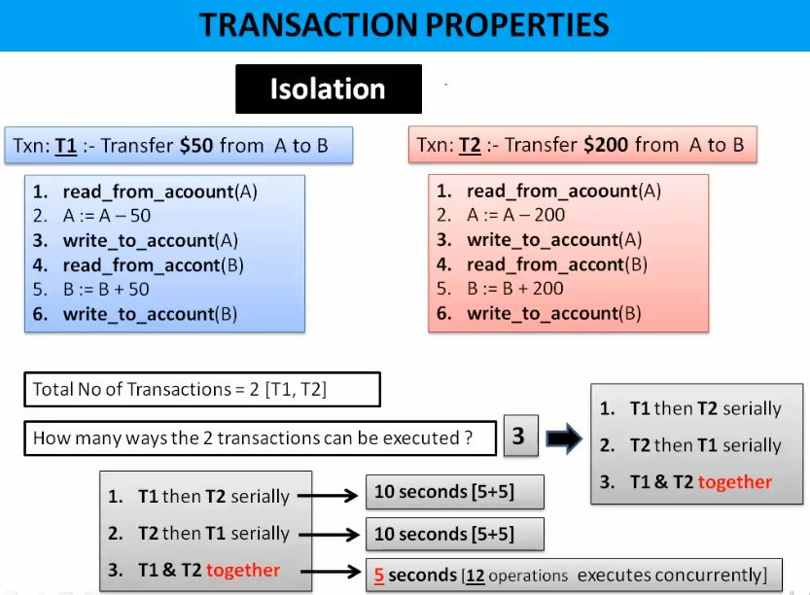

Slide 9
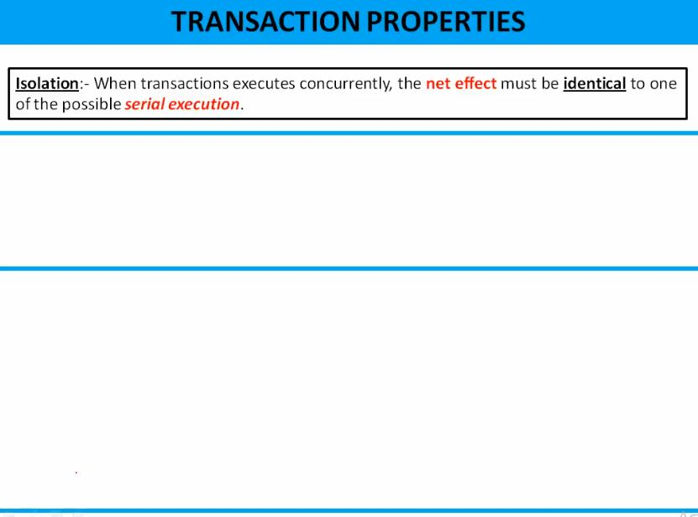
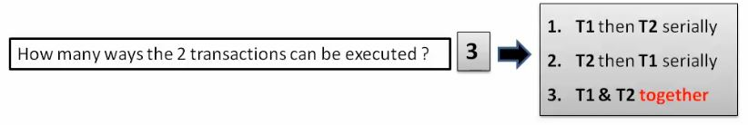
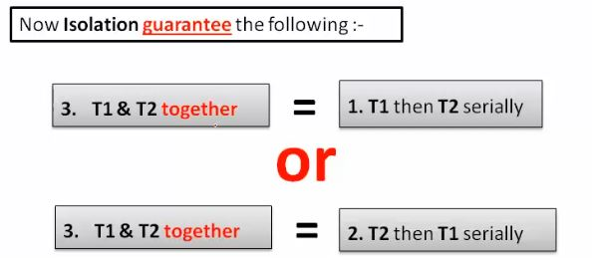

Slide 10
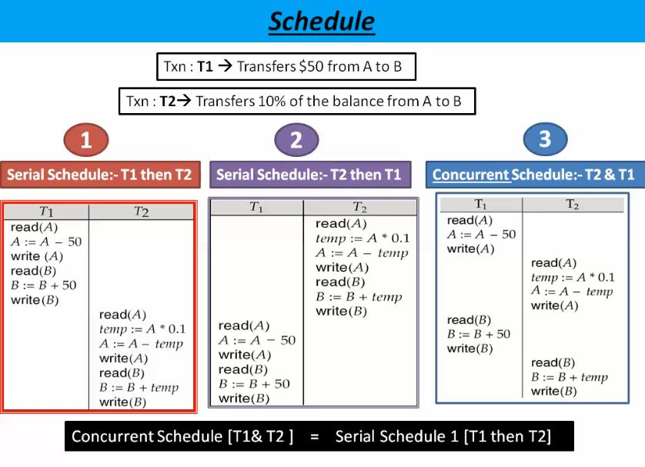

Slide 11
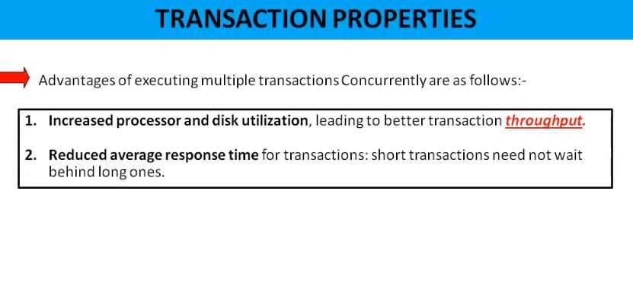

Slide 12
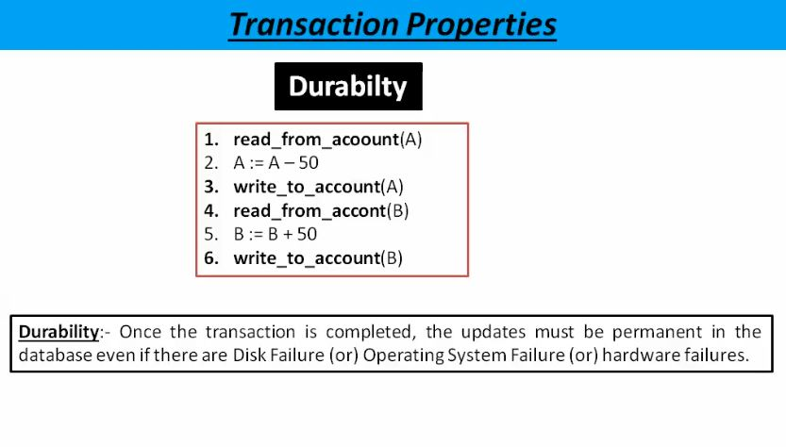

Slide 13
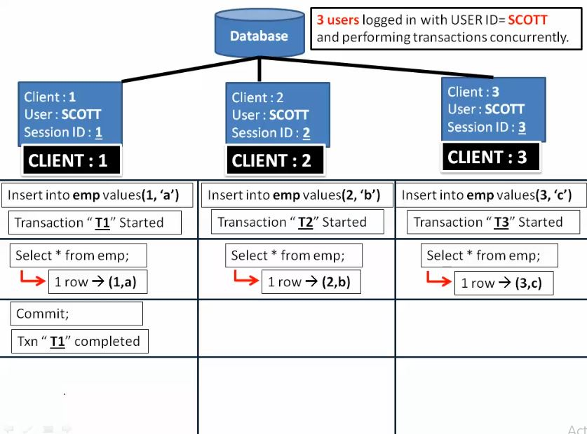
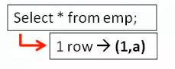
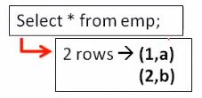
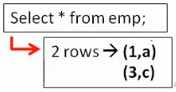

Slide 14
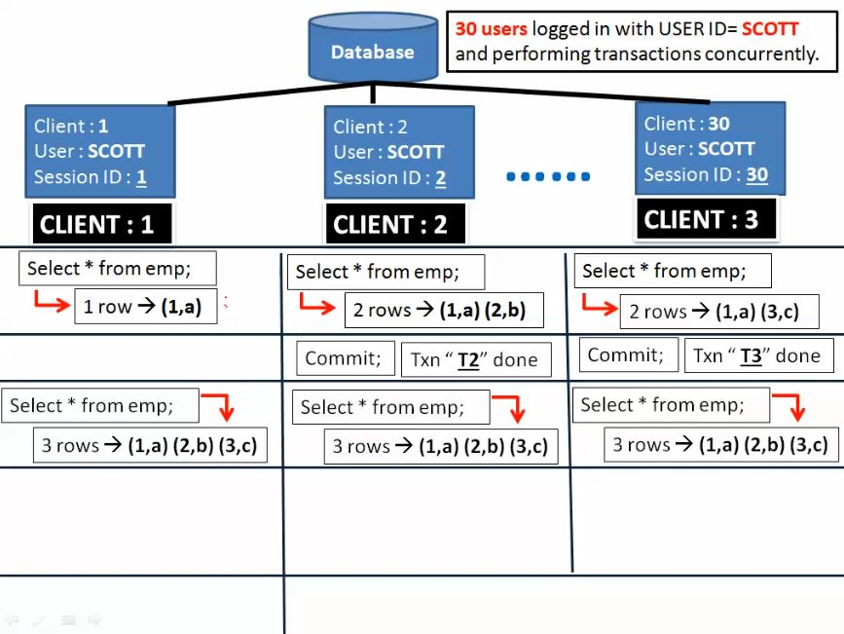
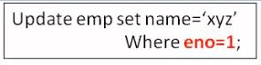
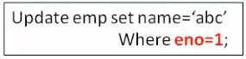
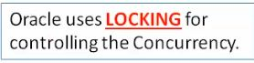
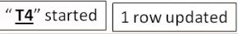

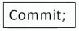
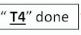
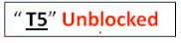
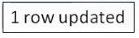

Slide 15
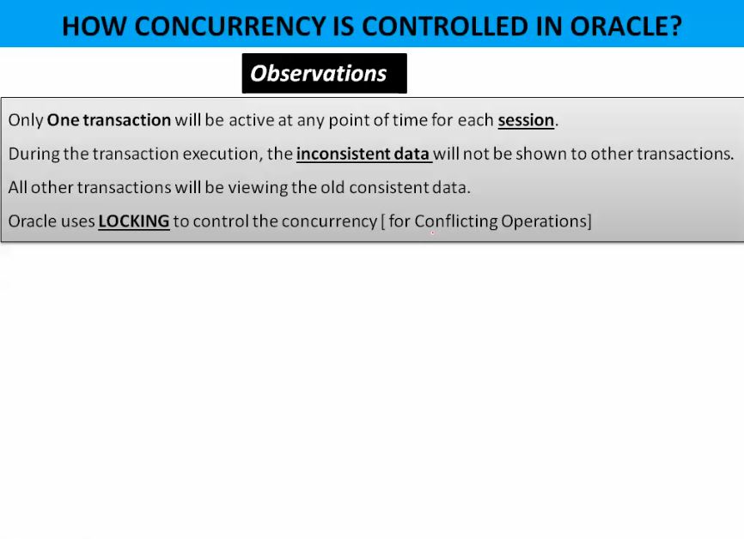
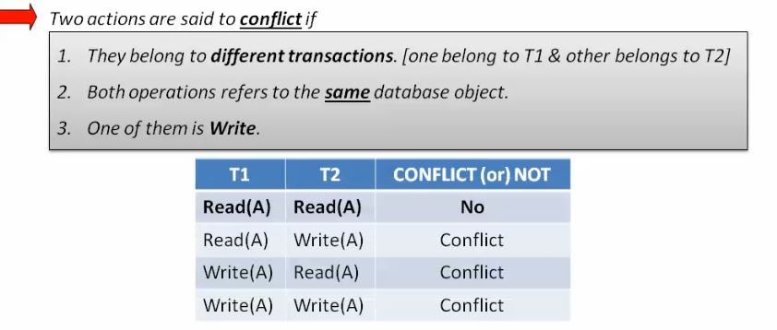

Slide 16
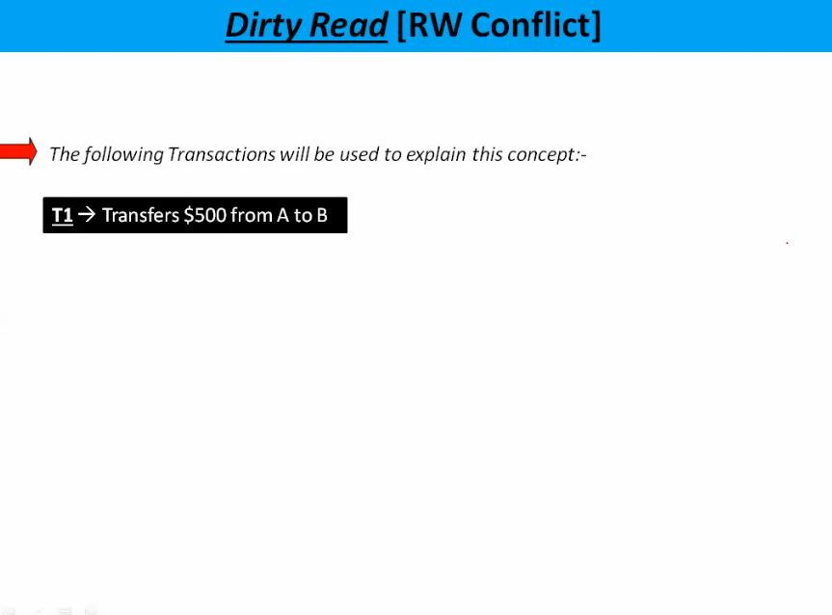

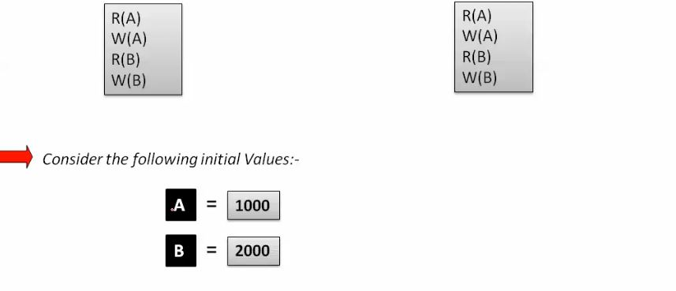

Slide 17
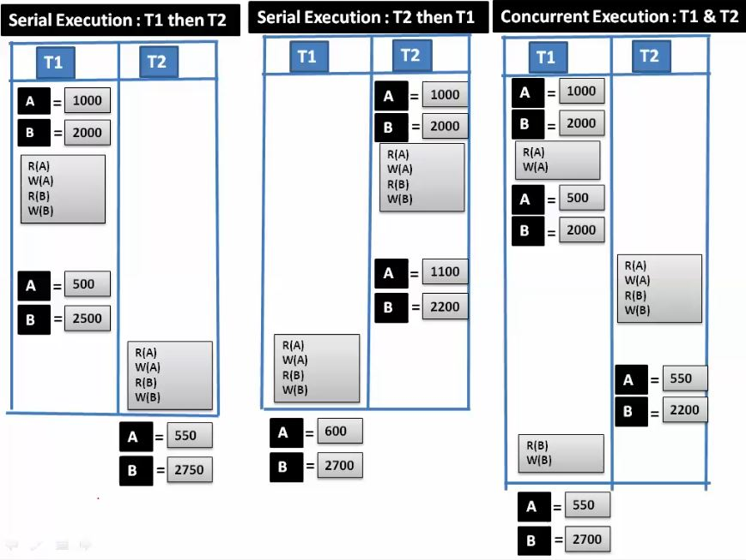
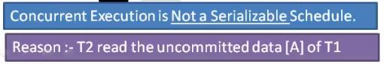

Slide 18
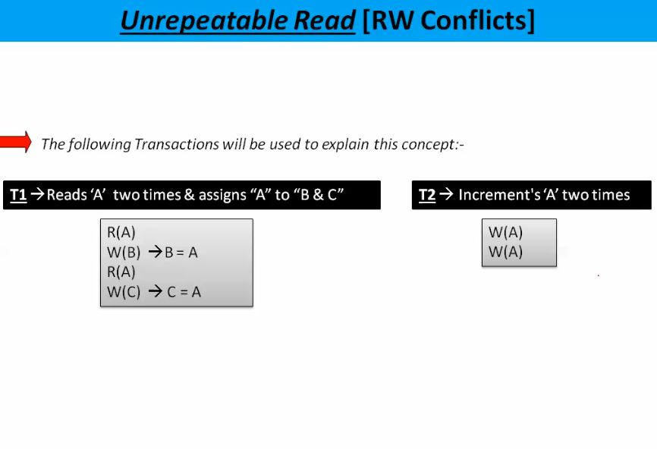
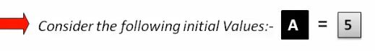

Slide 19
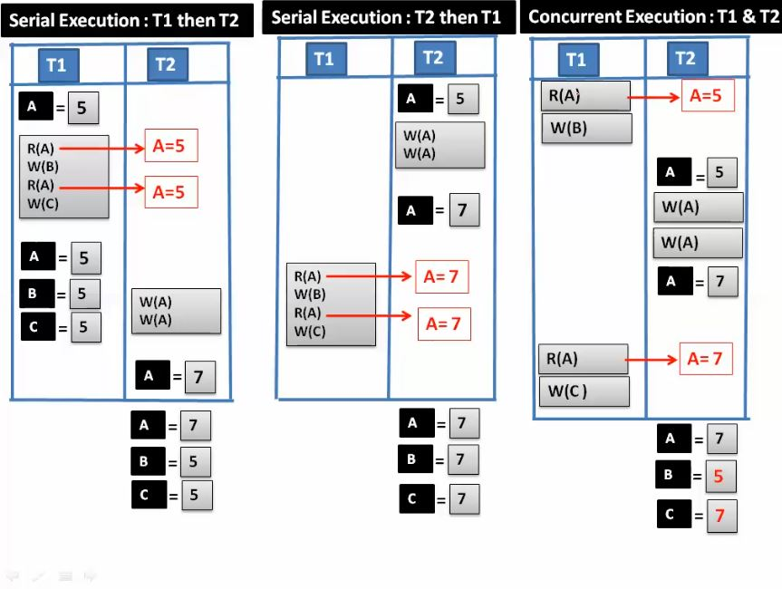

Slide 20
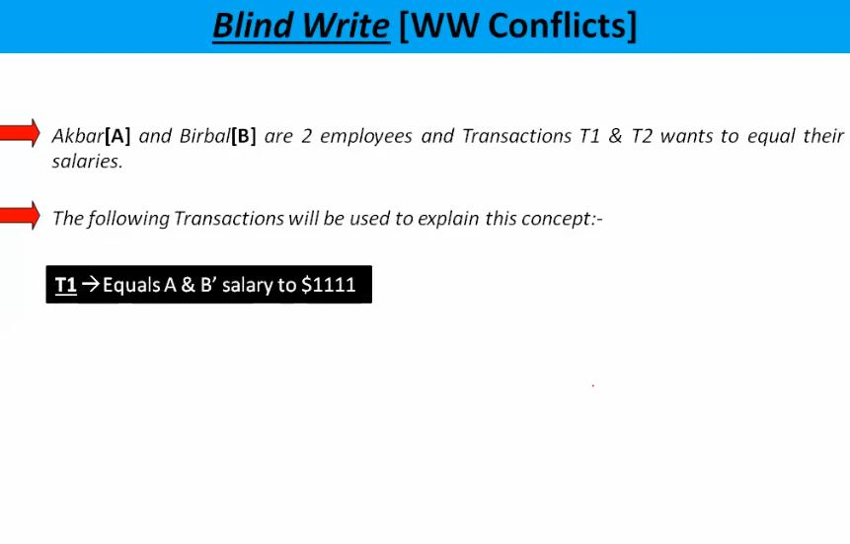

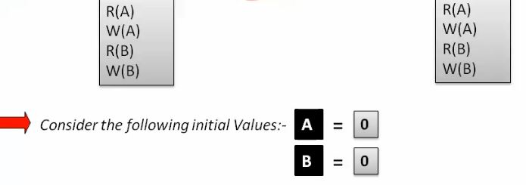

Slide 21
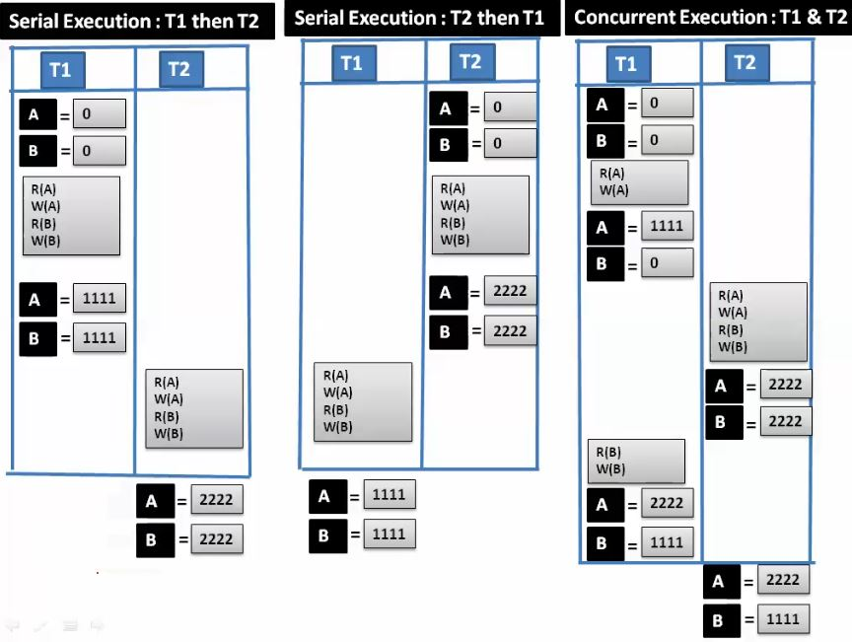

Slide 22
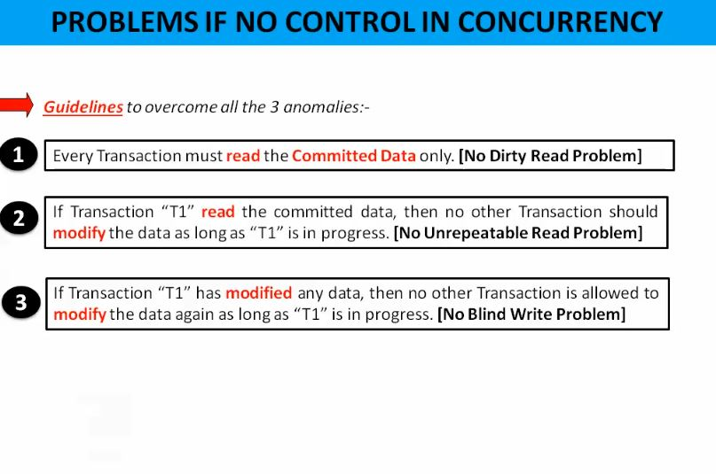
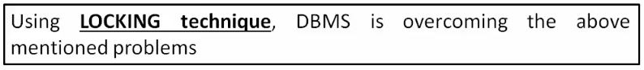

Slide 23
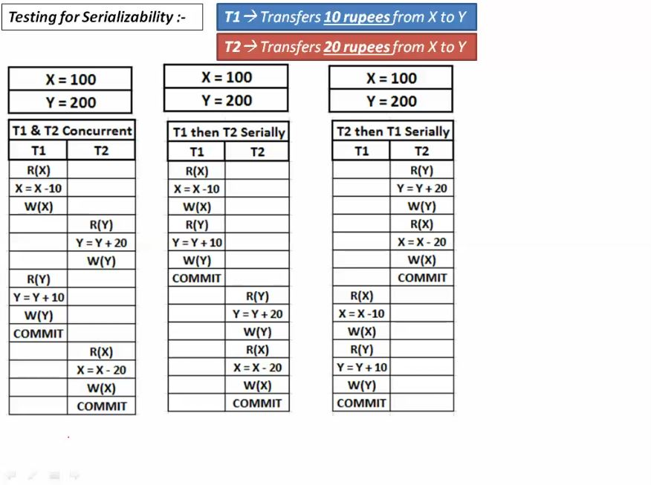
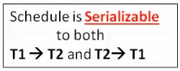
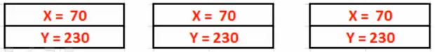

Slide 24
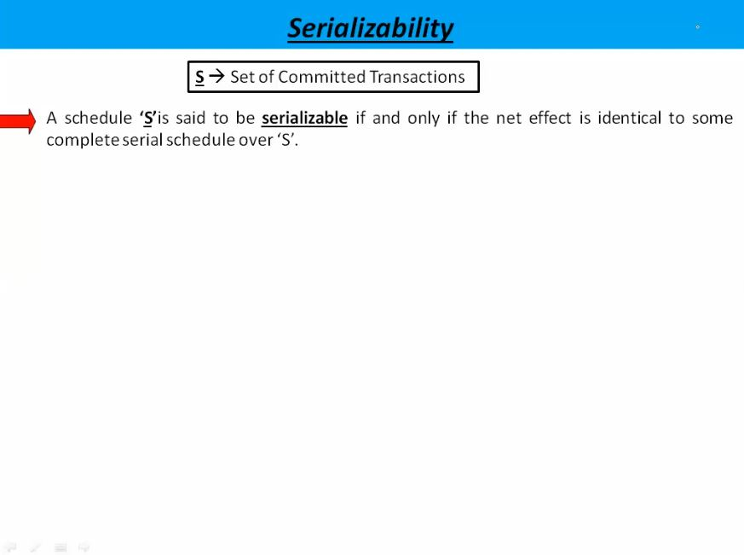
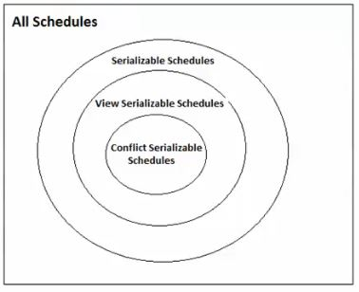

Slide 25
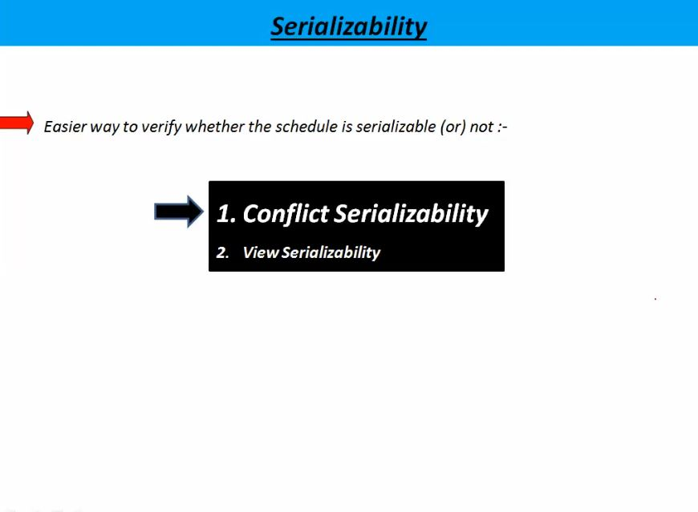

Slide 26




Slide 27



Slide 28


Slide 29


Slide 30


Slide 31


Slide 32


Slide 33


Slide 34



Slide 35




Slide 36






Slide 37






Slide 38
Types of Schedules in DBMS
Schedule, as the name suggests, is a process of lining the transactions and executing them one by one. When there are multiple transactions that are running in a concurrent manner and the order of operation is needed to be set so that the operations do not overlap each other, Scheduling is brought into play and the transactions are timed accordingly.

Slide 39


Slide 40
Serial Schedules: Schedules in which the transactions are executed non-interleaved, i.e., a serial schedule is one in which no transaction starts until a running transaction has ended are called serial schedules.
Example: Consider the following schedule involving two transactions T₁ and T₂.
T₁ | T₂
R(A)
W(A)
R(B)
 | W(B)
 | R(A)
 | R(B)
where R(A) denotes that a read operation is performed on some data item ‘A’ This is a serial schedule since the transactions perform serially in the order T₁ —> T₂

Slide 41
Non-Serializable: The non-serializable schedule is divided into two types, Recoverable and Non-recoverable Schedule.
Recoverable Schedule: Schedules in which transactions commit only after all transactions whose changes they read commit are called recoverable schedules. In other words, if some transaction T_{j} is reading value updated or written by some other transaction T_{i}, then the commit of T_{j} must occur after the commit of T_{i}.
Example – Consider the following schedule involving two transactions T₁ and T₂.
T₁ | T₂
R(A)
W(A)
 | W(A)
 | R(A)
commit
 | commit
This is a recoverable schedule since T₁ commits before T₂, that makes the value read by T₂ correct. There can be three types of recoverable schedule:

Slide 42

Cascading Schedule: Also called Avoids cascading aborts/rollbacks (ACA). When there is a failure in one transaction and this leads to the rolling back or aborting other dependent transactions, then such scheduling is referred to as Cascading rollback or cascading abort. Example:

Slide 43
Cascadeless Schedule: Schedules in which transactions read values only after all transactions whose changes they are going to read commit are called cascadeless schedules. Avoids that a single transaction abort leads to a series of transaction rollbacks. A strategy to prevent cascading aborts is to disallow a transaction from reading uncommitted changes from another transaction in the same schedule.
Example: Consider the following schedule involving two transactions T₁ and T₂.
T₁ | T₂
R(A)
W(A)
 | W(A)
commit
 | R(A)
 | commit
This schedule is cascadeless. Since the updated value of A is read by T₂ only after the updating transaction i.e. T₁ commits.

Slide 44
Strict Schedule: A schedule is strict if for any two transactions T_{i}, T_{j}, if a write operation of T_{i} precedes a conflicting operation of T_{j} (either read or write), then the commit or abort event of T_{i} also precedes that conflicting operation of T_{j}.
Example: Consider the following schedule involving two transactions T₁ and T₂.
T₁ | T₂
R(A)
 | R(A)
W(A)
commit
 | W(A)
 | R(A)
 | commit
This is a strict schedule since T₂ reads and writes A which is written by T₁ only after the commit of T₁.

Slide 45
Non-Recoverable Schedule: Example: Consider the following schedule involving two transactions T₁ and T₂.
T₁ | T₂
R(A)
W(A)
 | W(A)
 | R(A)
 | commit
abort
T₂ read the value of A written by T₁, and committed. T₁ later aborted, therefore the value read by T₂ is wrong, but since T₂ committed, this schedule is non-recoverable.

Slide 46

Note – It can be seen that:
Cascadeless schedules are stricter than recoverable schedules or are a subset of recoverable schedules.
Strict schedules are stricter than cascadeless schedules or are a subset of cascadeless schedules.
Serial schedules satisfy constraints of all recoverable, cascadeless and strict schedules and hence is a subset of strict schedules.
The relation between various types of schedules can be depicted as:

Slide 47

Transaction States
States through which a transaction goes during its lifetime. These are the states which tell about the current state of the Transaction and also tell how we will further do processing we will do on the transactions. These states govern the rules which decide the fate of the transaction whether it will commit or abort.

Slide 48
Active State – When the instructions of the transaction is running then the transaction is in active state. If all the read and write operations are performed without any error then it goes to “partially committed state”, if any instruction fails it goes to “failed state”.
Partially Committed – After completion of all the read and write operation the changes are made in main memory or local buffer. If the changes are made permanent on the Data Base then state will change to “committed state” and in case of failure it will go to “failed state”.
Failed State – When any instruction of the transaction fails it goes to “failed state” or if failure occurs in making permanent change of data on Data Base.
Aborted State – After having any type of failure the transaction goes from “failed state” to “aborted state” and in before states the changes are only made to local buffer or main memory and hence these changes are deleted or rollback.
Committed Stage – It is the stage when the changes are made permanent on the Data Base and transaction is complete and therefore terminated in “terminated state”.
Terminated State – If there is any roll back or the transaction come from “committed state” then the system is consistent and ready for new transaction and the old transaction is terminated.

Slide 49


Slide 50
Deadlock & Specialize Locking

Slide 51




Slide 52


Slide 53


Slide 54


Slide 55


Slide 56



Slide 57
Shared – Exclusive Locking
Shared Lock(S):- if transaction locked data items in shared mode then allowed to read only
Exclusive lock(X):- if transaction locked data items in shared mode then allowed to read and write both
T1 | T2
S(A)
R(A)
U(A)
 | X(A)
 | R(A)
 | W(A)
 | U(A)

Slide 58
Shared – Exclusive Locking
Problem in shared/exclusive locking:
May not free from irrecoverability
May not be free from deadlock
May not be free from starvation
T1 | T2
X(A)
 | X(B)
X(B)
 | X(A)
Deadlock

Slide 59
Shared – Exclusive Locking
Problem in shared/exclusive locking:
T1 | T2
X(A)
R(A)
W(A)
U(A)
 | X(A)
 | R(A)
 | W(A)
 | U(A)
 | COMMIT
*
T1 | T2 | T3 | T4
 | S(A)
X(A) | …
 | … | S(A)
 | U(A) | .. | S(A)
 |  | U(A) | …
 |  |  | U(A)
STARVATION
IRRECOVERABLE

Slide 60
2 –Phase locking
Growing phase:- locks are acquired and no locks are released
Shrinking phase:- locks are released and no locks are acquired
T1 | T2
X(A)
R(A)
W(A)
 | S(C)
 | R(C)
 | W(C)
S(B)
R(B)
U(A)
U(B)
 | U(C)
T1 | T2
S(A)
 | X(A)
X(B)
*
U(A)
 | X(D)
U(B)
 | U(A)
 | U(B)
T1---->T2

Slide 61
2 –Phase locking
Advantage :- always ensures serializability
Drawback:-
May not free from irrecoverability
May not be free from deadlock
May not be free from starvation
May not be free from cascading rollback

Slide 62
2 –Phase locking
T1 | T2 | T3 | T4
 | S(A)
X(A) | …
 | … | S(A)
 | U(A) | .. | S(A)
 |  | U(A) | …
 |  |  | U(A)
STARVATION
T1 | T2
X(A)
 | X(B)
X(B)
 | X(A)
DEADLOCK

Slide 63
2 –Phase locking
T1 | T2 | T3 | T4
X(A)
R(A)
W(A)
U(A)
 | S(A)
 | R(A)
 |  | S(A)
 |  | R(A)
 |  |  | S(A)
 |  |  | R(A)
*
IRRECOVERABLE & CASCADING ROLLBACK

Slide 64
2 –Phase locking
Strict 2PL:
It should satisfy the basic 2PL and all exclusive locks should hold until commit/abort
Rigorous 2PL:
It should satisfy the basic 2PL and all shared, exclusive locks should hold until commit/abort

Slide 65
2 –Phase locking
T1 | T2 | T3
X(A)
R(A)
W(A)
U(A)
 | S(A)
 | R(A)
 |  | S(A)
 |  | R(A)
*
T1 | T2
X(A)
R(A)
W(A)
 | S(A)
 | R(A)
Commit
U(A)

Slide 66
2 –Phase locking
T1 | T2
X(A)
R(A)
W(A)
 | S(A)
 | R(A)
 | …
 | …
 | …
Commit
U(A)

Slide 67





Slide 68



Slide 69
Two-phase Commit protocol
The steps performed in the two phases are as follows −
Phase 1: Prepare Phase
After each slave has locally completed its transaction, it sends a “DONE” message to the controlling site. When the controlling site has received “DONE” message from all slaves, it sends a “Prepare” message to the slaves.
The slaves vote on whether they still want to commit or not. If a slave wants to commit, it sends a “Ready” message.
A slave that does not want to commit sends a “Not Ready” message. This may happen when the slave has conflicting concurrent transactions or there is a timeout.

Slide 70
Two-phase Commit protocol
Phase 2: Commit/Abort Phase
After the controlling site has received “Ready” message from all the slaves −
The controlling site sends a “Global Commit” message to the slaves.
The slaves apply the transaction and send a “Commit ACK” message to the controlling site.
When the controlling site receives “Commit ACK” message from all the slaves, it considers the transaction as committed.

Slide 71
Two-phase Commit protocol
After the controlling site has received the first “Not Ready” message from any slave −
The controlling site sends a “Global Abort” message to the slaves.
The slaves abort the transaction and send a “Abort ACK” message to the controlling site.
When the controlling site receives “Abort ACK” message from all the slaves, it considers the transaction as aborted.

Slide 72
Log based recovery (deferred database modification)
A = 100
B = 200
T1
R(A)
A=A+100
W(A)
R(B)
B=B+200
W(B)
COMMIT
*
Log
<T1,START>
<T1,A,200>
<T1,B,400>
<T1,COMMIT>
A = 200
B = 400
<TRANSACTION NUMBER, OBJECT, NEW VALUE>
REDO – NEW VALUE WILL BE UPDATED IN PERMANENT STORAGE

Slide 73
Log based recovery (deferred database modification)
A = 100
B = 200
T1
R(A)
A=A+100
W(A)
R(B)
B=B+200
W(B)
*
Log
<T1,START>
<T1,A,200>
<T1,B,400>
<TRANSACTION NUMBER, OBJECT, NEW VALUE>
NO OPERATION WILL BE DONE

Slide 74
Log based recovery (deferred database modification)
A = 100
B = 200
C = 500
Log
<T1,START>
<T1,A,200>
<T1,B,400>
<T1,COMMIT>
<T2,START>
<T2,C,500>
*
A = 200
B = 400
C = 500
T1 WILL BE REDO, FOR T2 NO OPERATION WILL BE DONE AS IT IS NOT COMMITED

Slide 75
Log based recovery (Immediate database modification)
A = 100
B = 200
T1
R(A)
A=A+100
W(A)
R(B)
B=B+200
W(B)
COMMIT
*
Log
<T1,START>
<T1,A,100,200>
<T1,B,200,400>
<T1,COMMIT>
A = 200
B = 400
<TRANSACTION NUMBER, OBJECT,OLD VALUE, NEW VALUE>
REDO – NEW VALUE WILL BE UPDATED IN PERMANENT STORAGE

Slide 76
Log based recovery (Immediate database modification)
A = 100
B = 200
T1
R(A)
A=A+100
W(A)
R(B)
B=B+200
W(B)
*
Log
<T1,START>
<T1,A,100,200>
<T1,B,200,400>
A = 200
B = 400
<TRANSACTION NUMBER, OBJECT,OLD VALUE, NEW VALUE>
A = 100
B = 200
UNDO – OLD VALUE WILL BE UPDATED IN PERMANENT STORAGE

Slide 77
Log based recovery (Immediate database modification)
A = 100
B = 200
C = 500
Log
<T1,START>
<T1,A,100,200>
<T1,B,200,400>
<T1,COMMIT>
<T2,START>
<T2,C,500,600>
*
A = 200
B = 400
C = 500
T1 WILL BE REDO, T2 WILL BE UNDO

Slide 78
Timestamp ordering protocol

Slide 79
Rules for timestamp ordering protocol
1) Transaction Ti issue a Read(A) operation
A) if WTS(A) > TS(Ti), then Rollback Ti
B) Otherwise execute R(A) operation,
set RTS(A)=Max{RTS(A),TS(Ti)}
2) Transaction Ti issue a Write(A) operation
A) if RTS(A) > TS(Ti), then Rollback Ti
B) if WTS(A) > TS(Ti), then Rollback Ti
C) Otherwise execute write(A) operation,
set WTS(A)=TS(Ti)

Slide 80


Slide 81


